Slide 1

Pickle Rick
Reto Stadelmann, Benjamin Herger & Jonas Stalder

Slide 2
Die Idee

Slide 3


Slide 4
Die Reaktion

Slide 5


Slide 6
Demotime

Slide 7
Progress

Slide 8
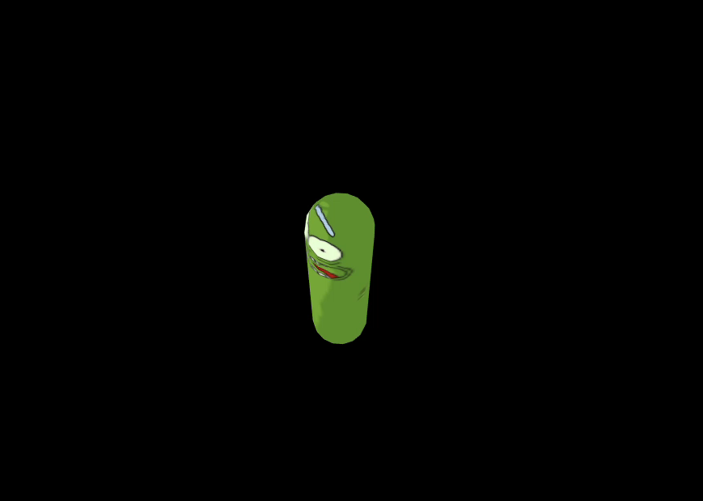

Slide 9
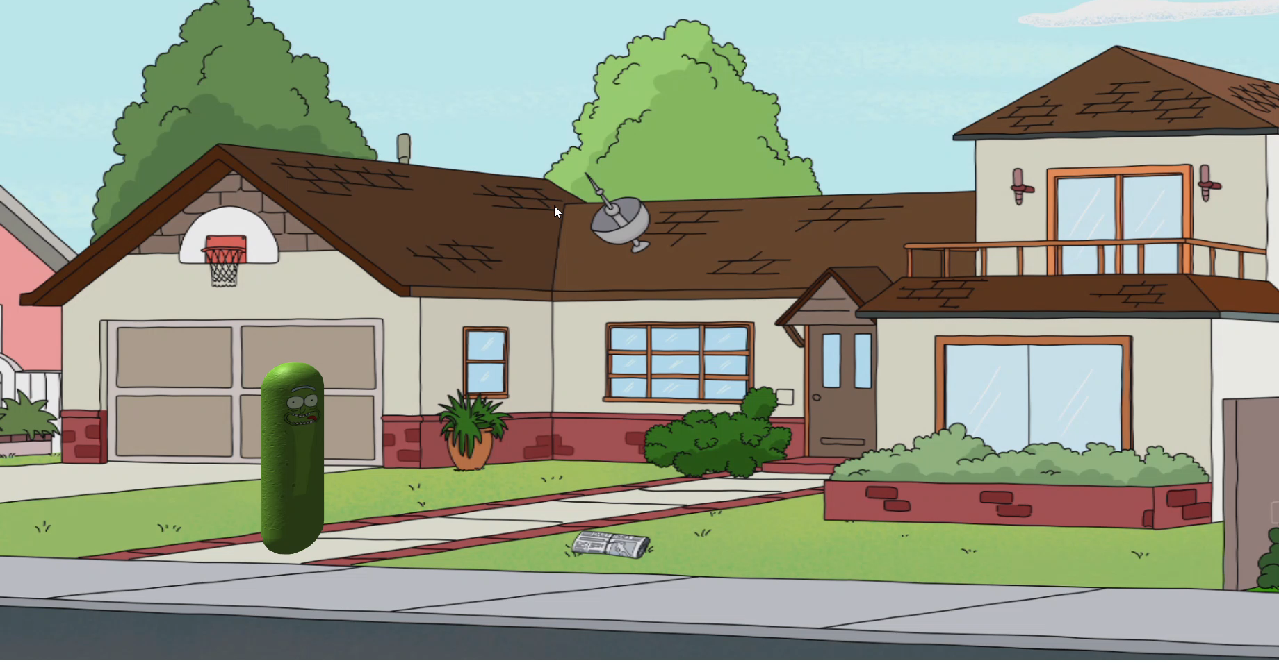

Slide 10
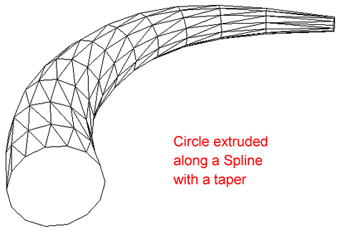
https://cadcamengineering.net/autocad_more-about-extruding-lofting/

Slide 11
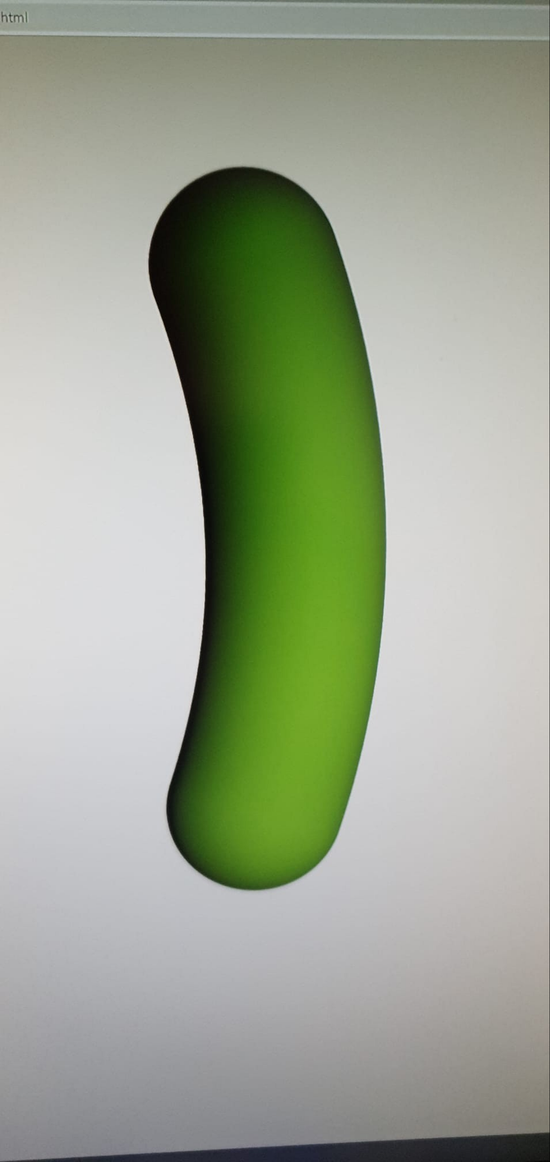

Slide 12
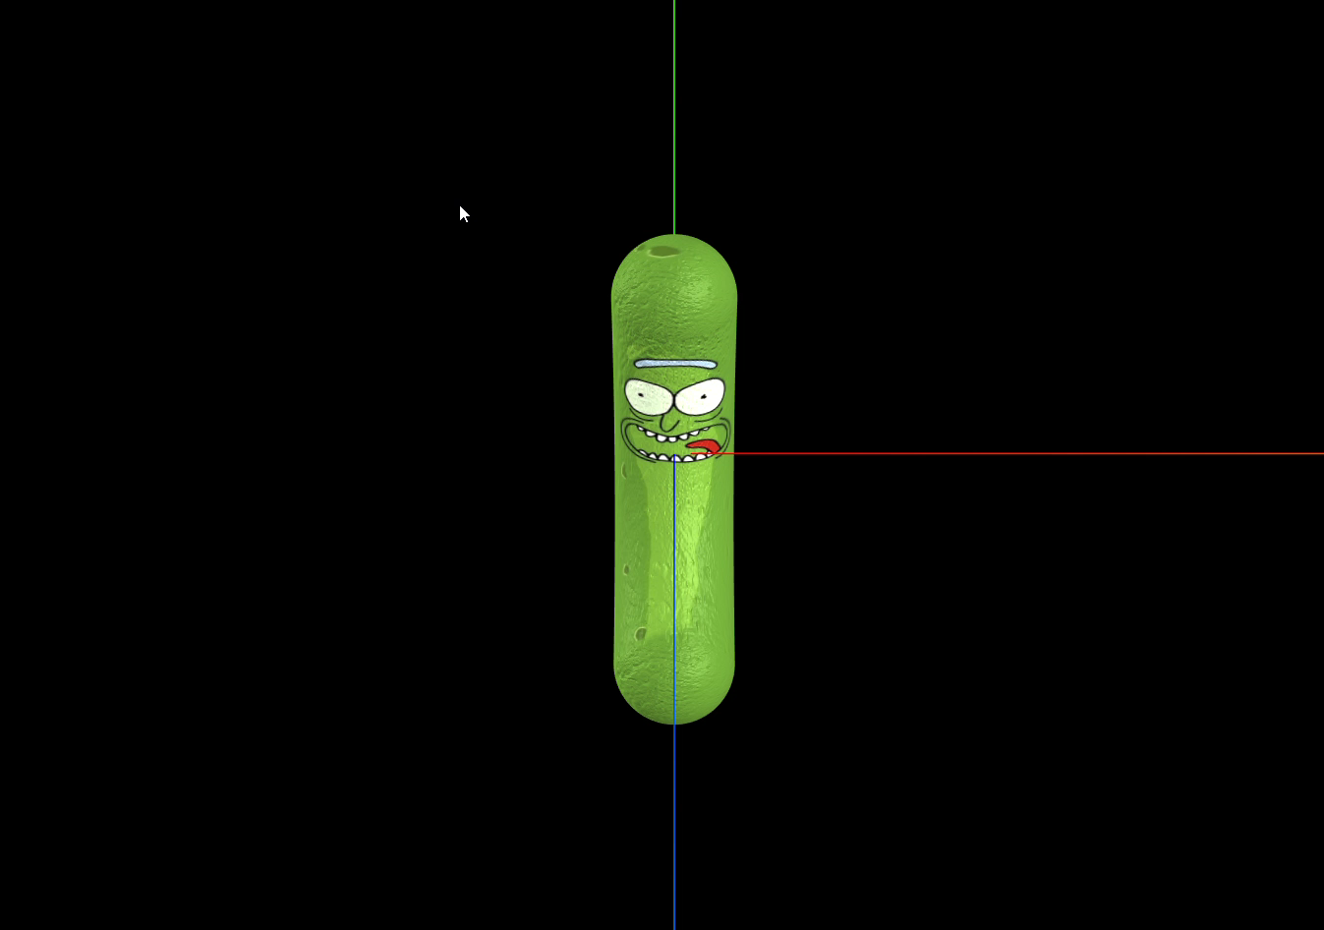

Slide 13
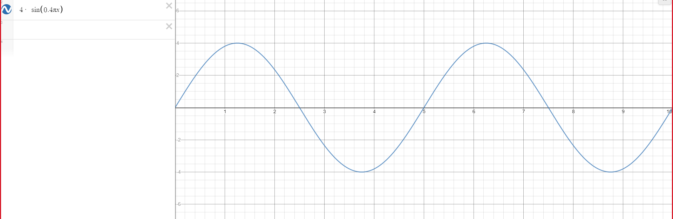
Jump

Slide 14
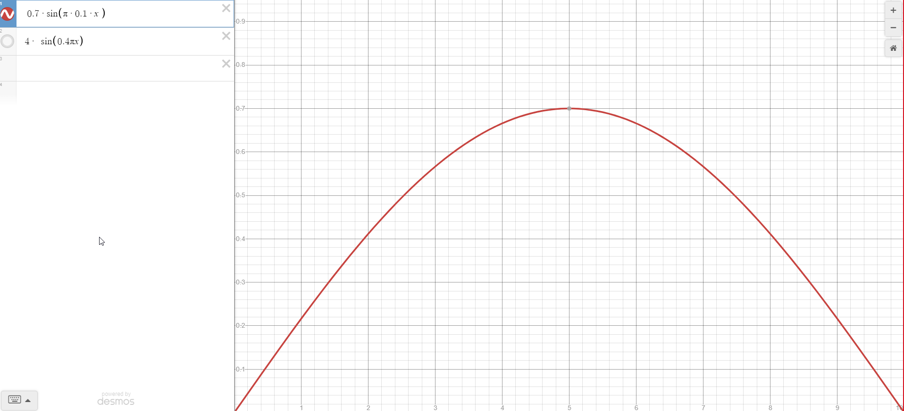
Spin

